Slide 1


Truck Simulator
By,
Jonathan Jenkins
ME 5751: Robotic Motion Planning Dec 8, 2022

Slide 2
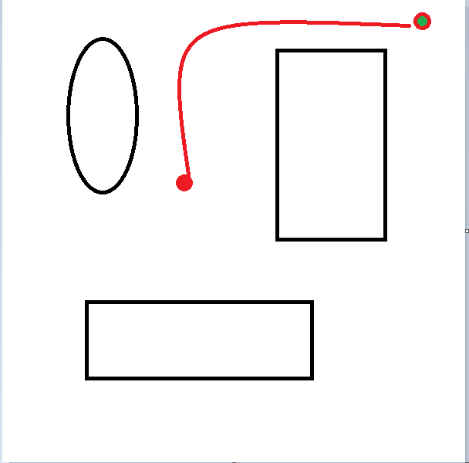
Objective
Develop a Truck Based motion planner
Construct a collision - free path between some initial position to some goal position.
Implement Truck kinematics to constrain the simulated robot motion

Slide 3
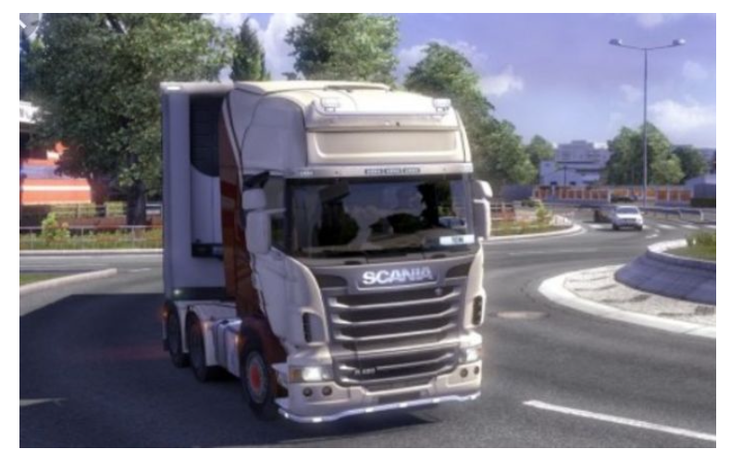
Requirements
Rubric 1: Potential map generation
Rubric 2: Path planner
Rubric 3: P - controller
Rubric 4: Wheel Kinematics of a truck

Slide 4
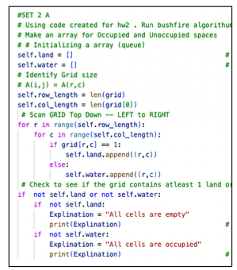

Potential Map Generation
Takes 500*500-pixel map and converts it into a 500*500 matrix map
Using a function to identify empty spaces ( white) and occupied spaces (black).

Slide 5
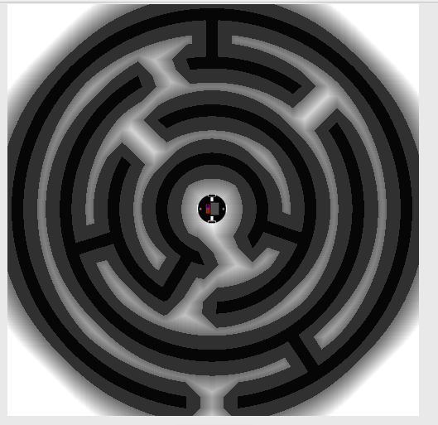
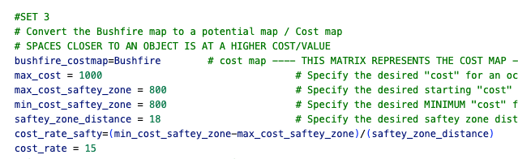
Potential Map Generation
Assign a risk value to all empty spaces.
Spaces closer to an occupied space will be given a higher risk, While spaces that are farther away are assigned a lower risk.
Black – 1000
Safety-zone – 850
Unoccupied space 800---- 0

Slide 6
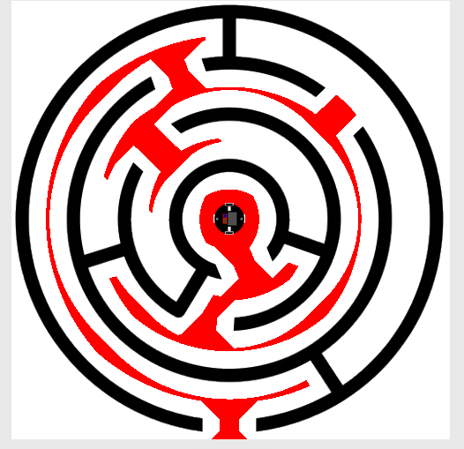
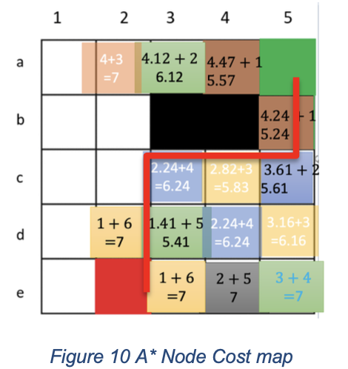
Path Generation
A planner decides what grids should the robot move to reach the desired location
A* Algorithm
combines Breadth First Search (BFS) and Dijkstra algorithm
BFS algorithm assigns each grid a value corresponding to the distance from the starting position
Dijkstra’s algorithm assigns each grid a value corresponding to the distance from the goal position

Slide 7
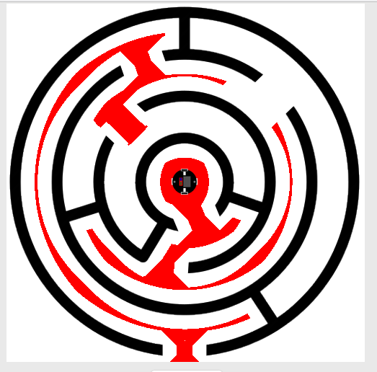
Dual Search A* Algorithm
The A* algorithm uses both BFS and Dijkstra’s algorithm to find an efficient path between the start and the goal . A* algorithm priority search allows it to find a path without the need to search the entire map.
We implement a dual A* search starting from both the goal position and the start position simultaneously.
With a dual search the program can scan from two location congruently, ideally allowing the program to locate a final path faster.

Slide 8
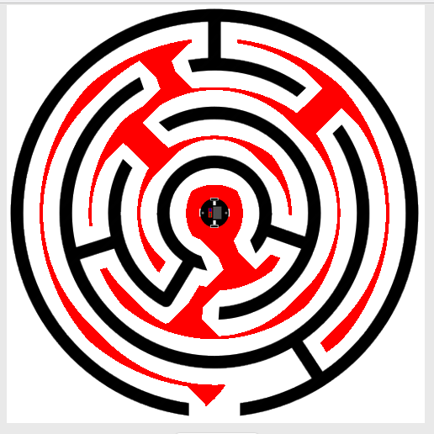
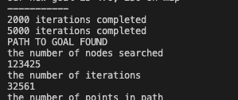
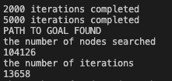
A* Algorithm Improvements
Single Search
Dual Search
56% Iterations Reduction

Slide 9
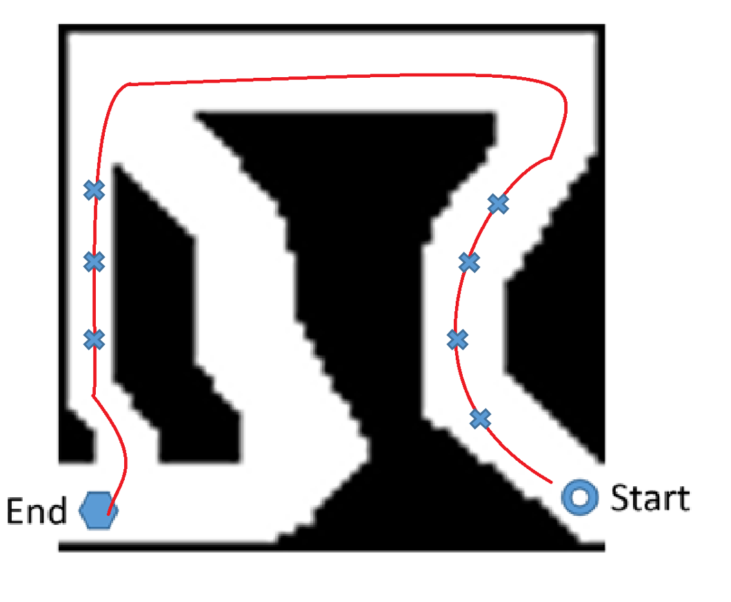
Point Tracking
Converting our found path to robot waypoints.
Point tracking
We discretize the paths into a set of waypoints (positions)
Assign a direction value to each waypoint
Reduce the number of waypoints in a path to maximize efficiency

Slide 10
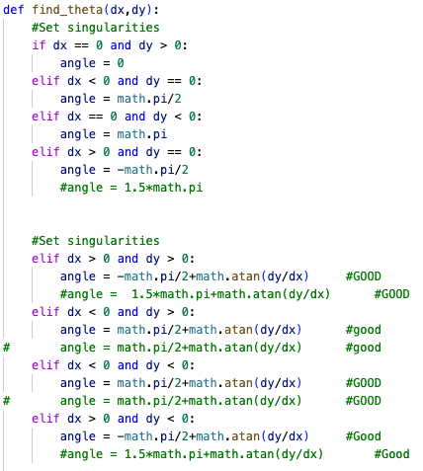
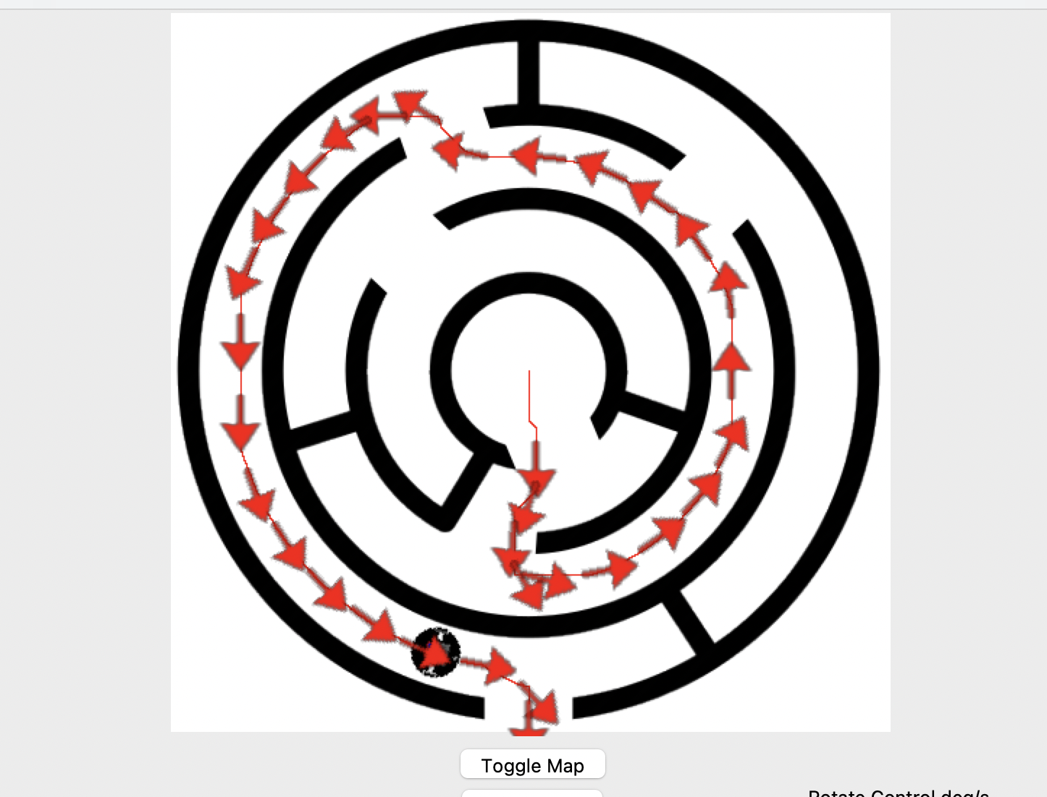
Point tracking
Create a list of waypoints from a fraction of points in the found path
Each Waypoint is assigned a theta value based on the travel direction from the previous waypoint

Slide 11
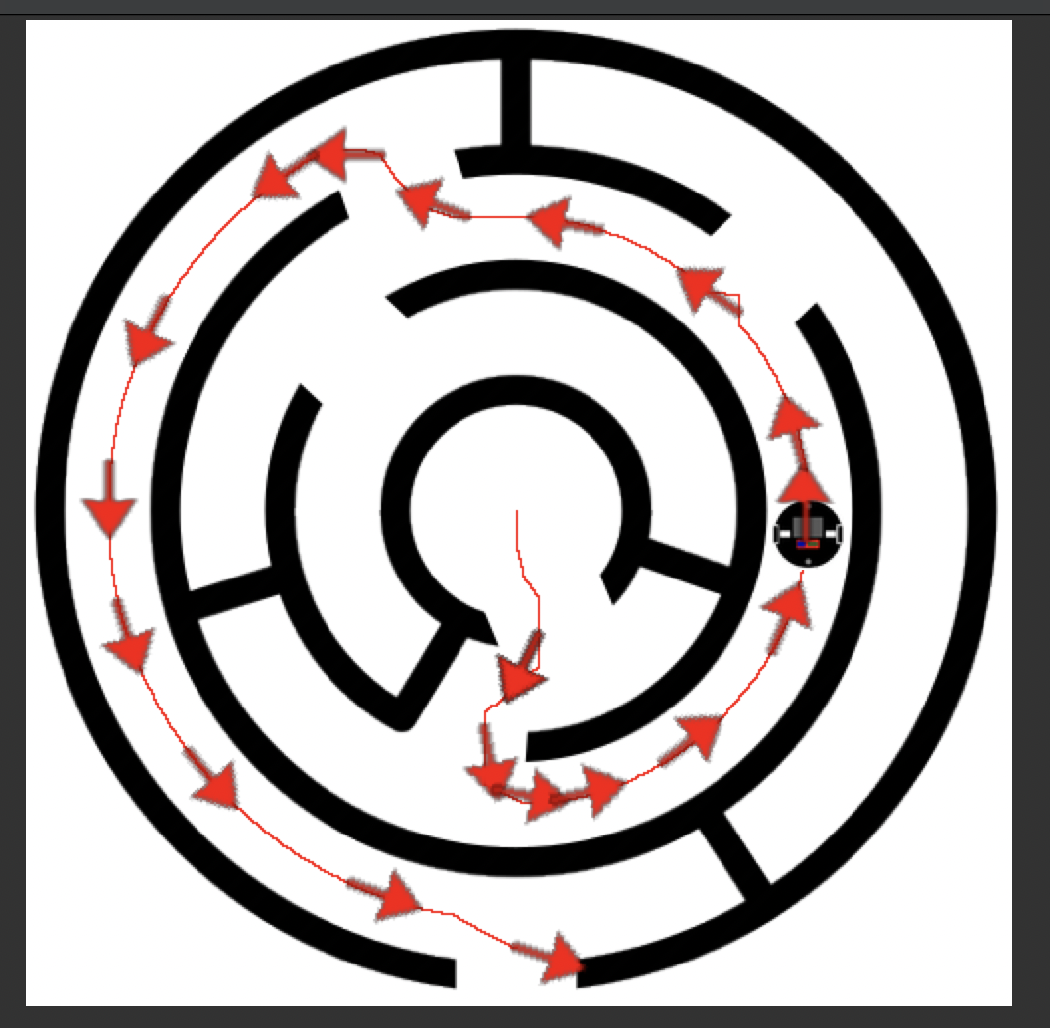
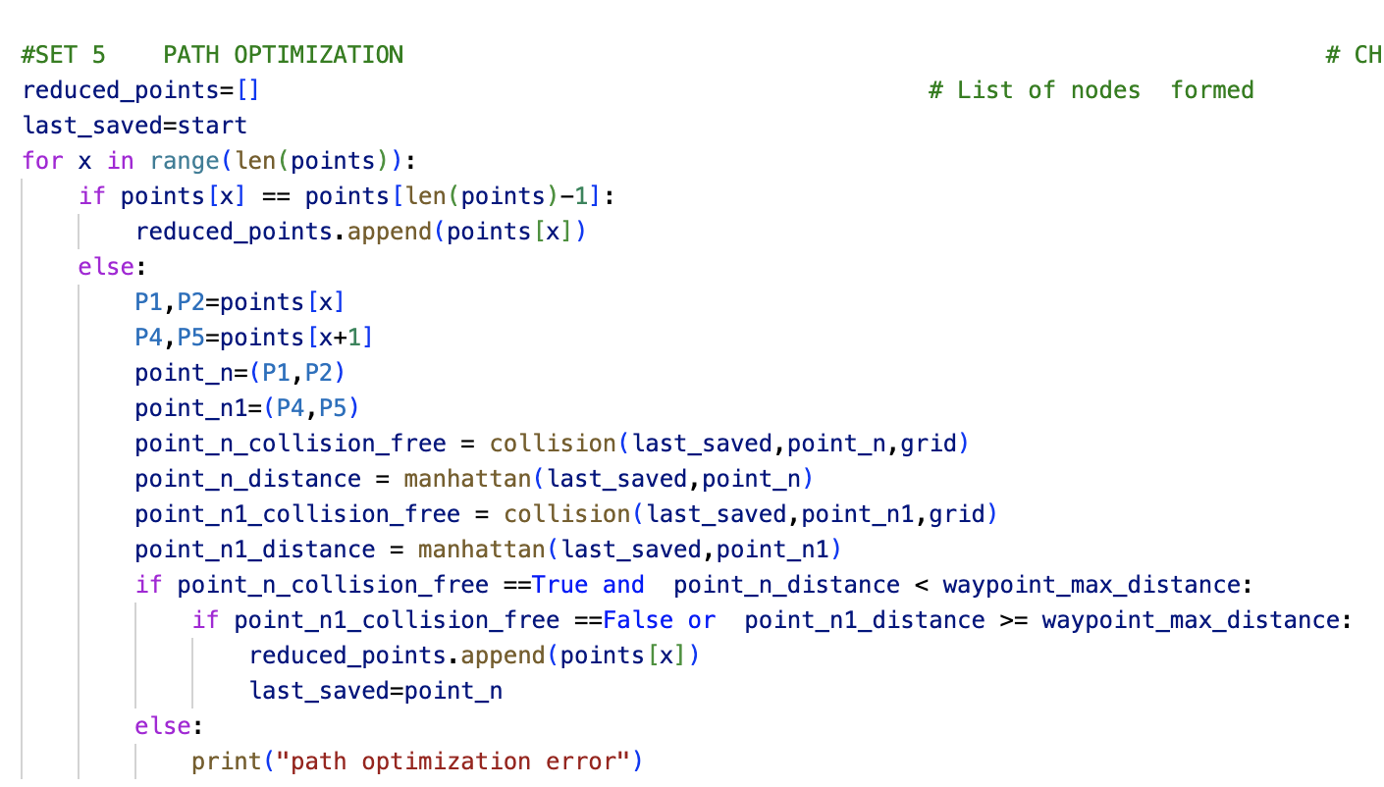
Point tracking
Further reduction of waypoints based on linear distance and theta value.
Sharp turns will have more waypoints for higher resolution
Strait paths will have less points

Slide 12
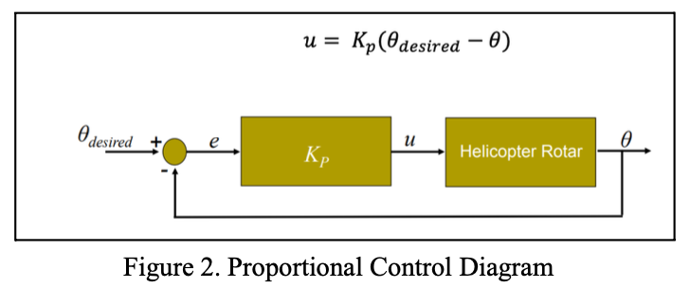
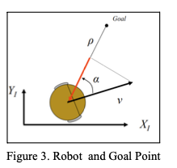
Controller
Proportional control (P control) is a type of linear feedback control system in which a correction is applied to the controlled variable.
Error (e) : the difference between the desired value and the measured value.
Proportional gain (k) : the size of the correction that will be implemented
A P-Control was used to adjust the robot’s linear and angular velocity in order to control it to reach a desired point (goal point)

Slide 13
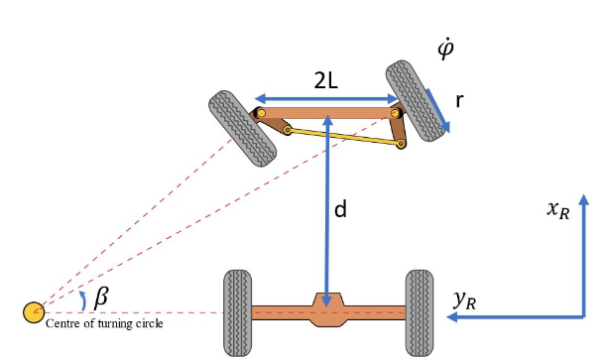
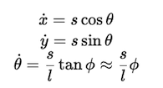
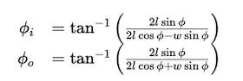
Truck Dynamics
A truck has certain kinematic constraints . Based on the vehicle design and limitations we need to implement limitations to allow for accurate simulation.
Car width : 2L = 16
Car axile distance : d = 20
Wheel diameter : r = 3
Steering angle : b < 40 Degrees
Wheel speed : rho < 20 rad/s

Slide 14
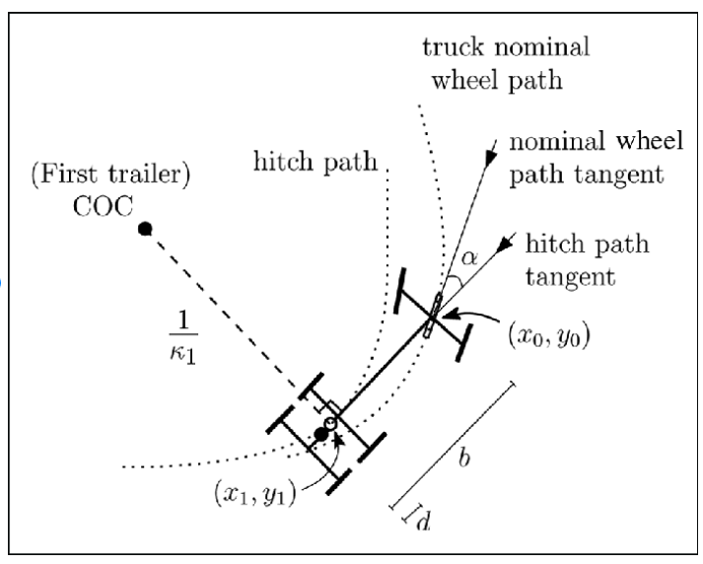
Truck Dynamics
Incorporating the desired velocity and rotation from the p-controller and limiting the output based on the truck kinematics
P Controller + Truck Kinematics
Limit outputs based on known constraints
Outputs the final vehicle linear and angular velocity that will be executed.

Slide 15
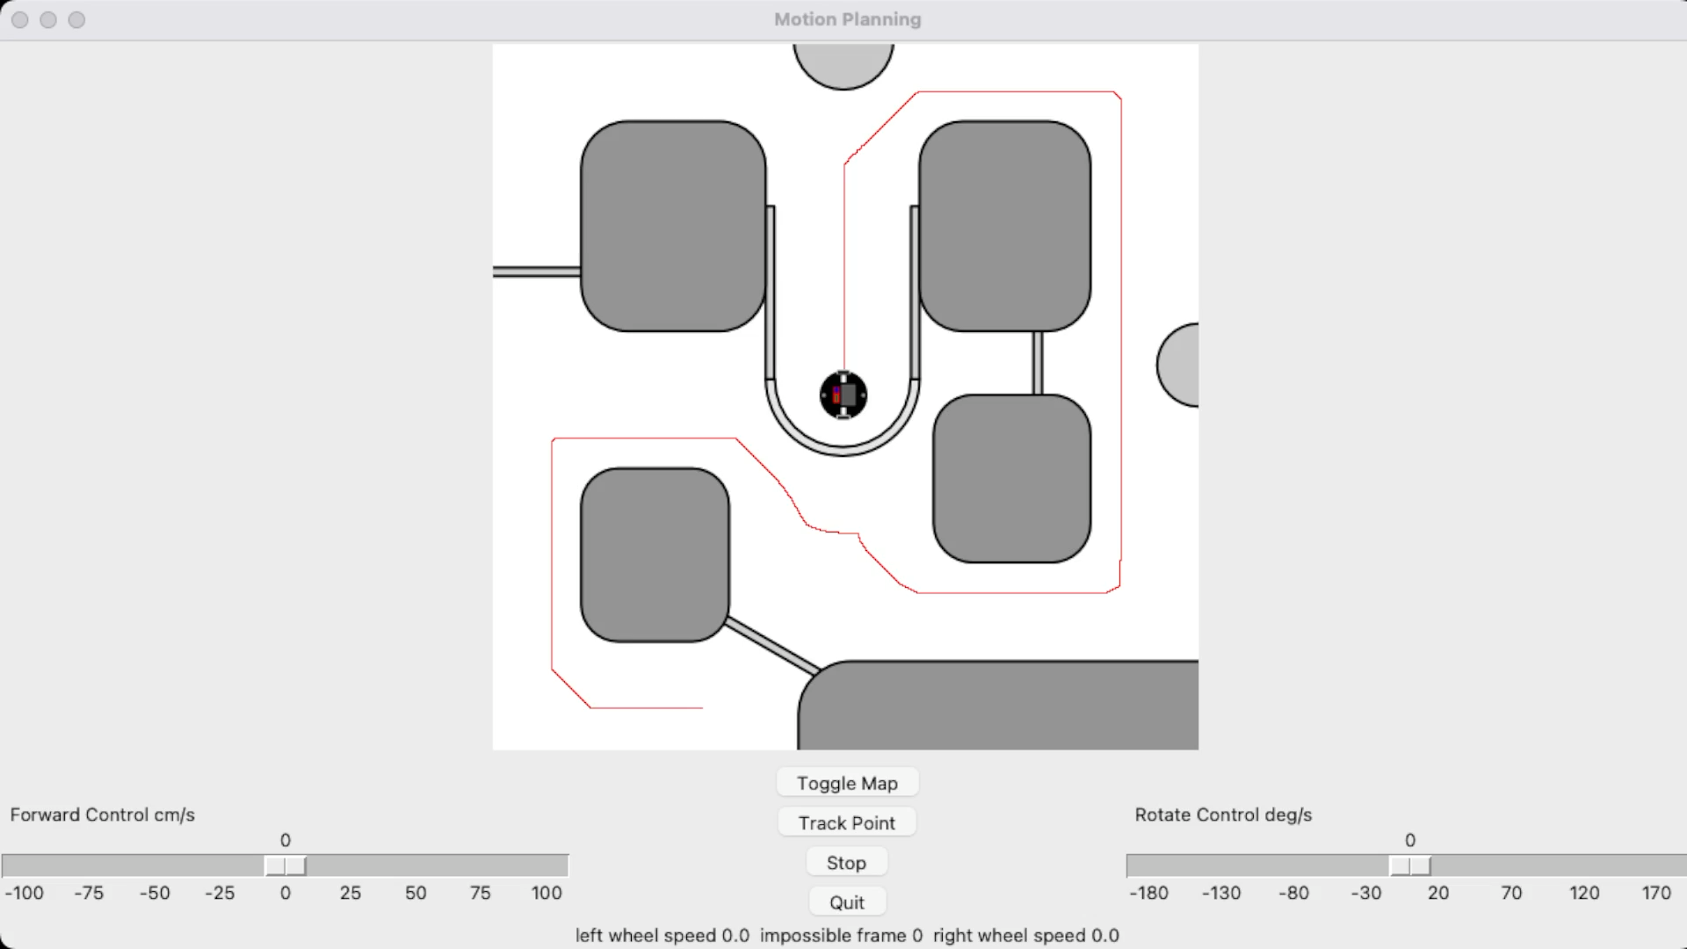
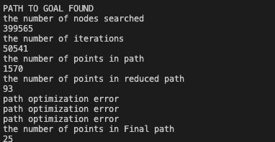
Demonstration

Slide 16
Link To Online Video
https://youtu.be/2k3NQvptN9E

